Slide 1
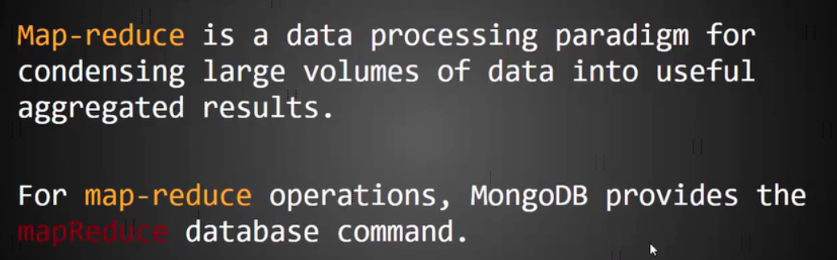
Map-Reduce in MongoDB

Slide 2
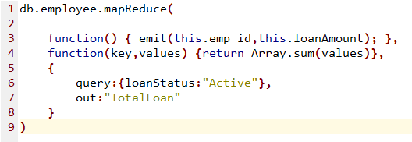
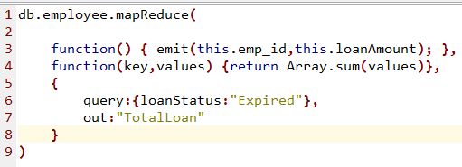
Map-Reduce in MongoDB
Each Employees total sum of Active loans
Each Employees total sum of Expired loans

